Slide 1
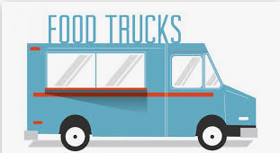
Predicting Locations For Food Truck

Slide 2
The Need to Predict Locations !
Every Business Needs Customers and the Question most often asked is where can we find them ?
Where do we put up our Business so that we have a regular stream of Customers passing by ?
Will I get a decent ROI if I choose this location to set up my Business ?
Do we set up our Food Truck near a Mall or College or Market or nearby Corporate Offices.
The only answer to all the above questions is Location Analytics
- Accurate

Slide 3
Data Acquisition and Cleaning
Two main sources of data
Foursquare API for Location Data of Businesses in Downtown Toronto
Wikipedia page on Postal Codes of Canada
Data Cleansing
Removed blank spaces and blank rows from source data files
Renamed columns to help with merging data from different datasets
Filtered columns as required by either Maps or Predictive Models
Data conversions were also done as per needs during development
- Accurate

Slide 4
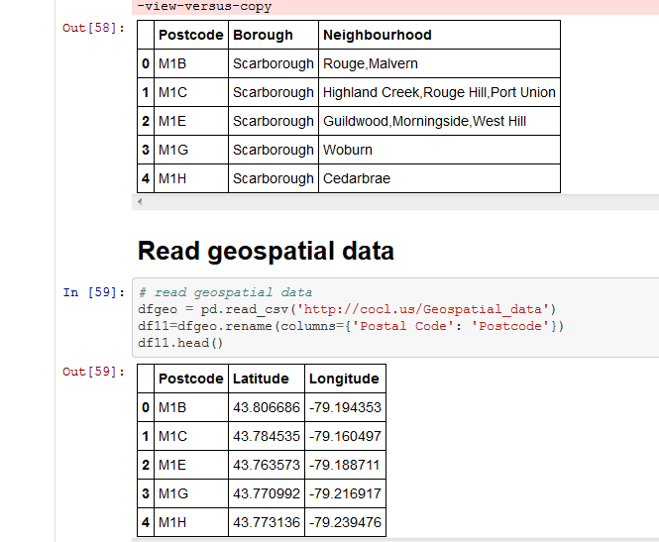
Renaming Columns for Data Merge
- Accurate

Slide 5
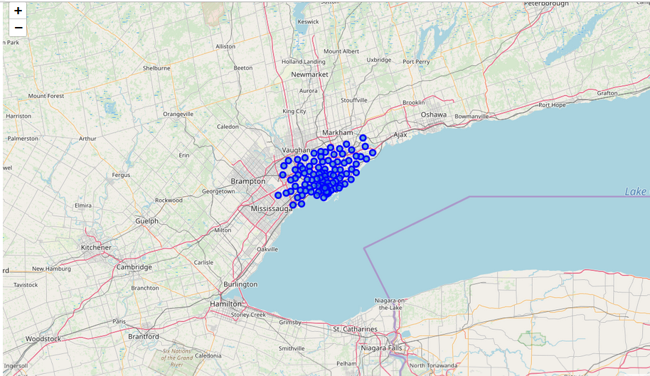
Exploring Data Using Maps
Plotting
Neighborhoods
In
Downtown Toronto
- Accurate

Slide 6
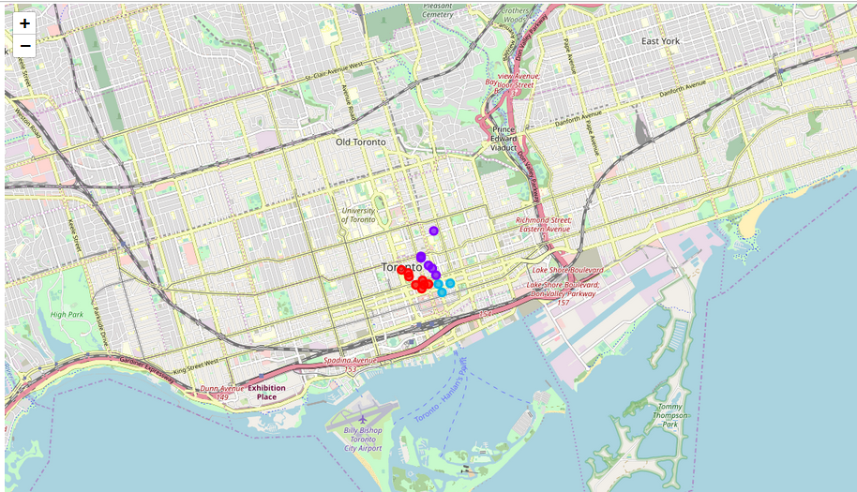
Modeling with K Means Clustering For only Business Locations
Plotting
Business
Locations
In
Downtown Toronto
- Accurate

Slide 7
Results of Current Analysis
Overall the Business Areas of Downtown Toronto can be divided into 3 Clusters based on the Distances between the central point of Downtown Toronto and the geo locations of the Business/Offices.
We have narrowed our Top 2 locations for the Food Truck are Adelaide King, Richmond and Ryerson,Garden District in Downtown Toronto.
Within Ryerson, Garden District -> The businesses Law and Business Student Association and Links of London are closers to each other so the Food Truck can be placed at their intersections.
Within Adelaide King, Richmond -> The businesses Fitness Centre and Global Business & Legal Services are very close to each other. So placement of a Food Truck in this area is also ideal.
- Accurate

Slide 8
Conclusions
Any food business before commencement will require a proper study of location, menu, target crowd and market demands.
This study will help in the ideal placement of a Food Truck and gauge the risks faced by a business with regards to location & geo limitations.
Finally, the above analysis can be applied to any Mobile Food van that requires Location Analytics.
- Accurate

